Slide 1
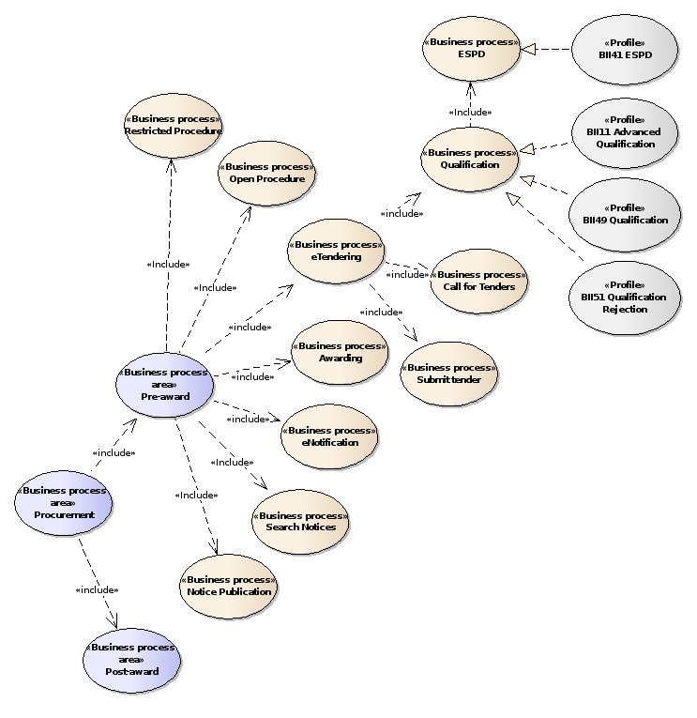

Slide 2
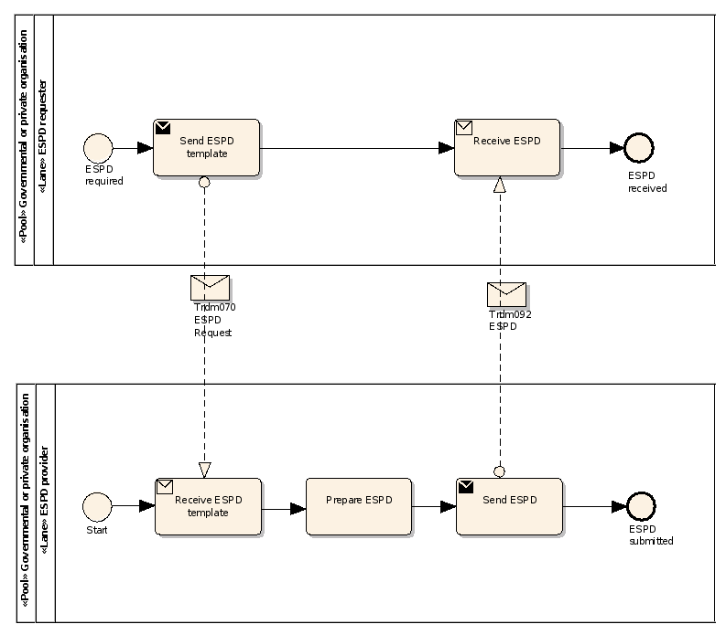
QualificationApplicationRequest
QualificationApplicationResponse

Slide 3
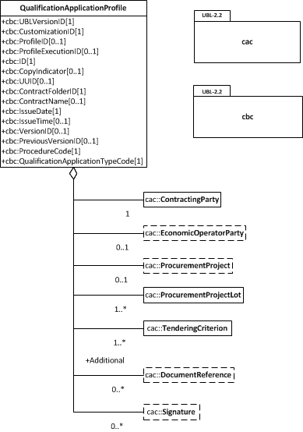

Slide 4
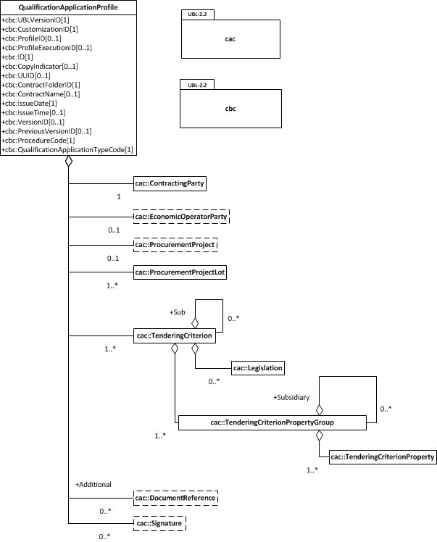

Slide 5
EXCLUSION
CONVICTIONS
PARTICIPATION_IN_CRIMINAL_ORGANISATION, CORRUPTION, FRAUD, TERRORIST_OFFENCES,
MONEY_LAUNDERING, CHILD_LABOUR-HUMAN_TRAFFICKING
CONTRIBUTIONS
PAYMENT_OF_TAXES, PAYMENT_OF_SOCIAL_SECURITY
SOCIAL
ENVIRONMENTAL_LAW, SOCIAL_LAW, LABOUR_LAW
BUSINESS
BANKRUPTCY, INSOLVENCY, CREDITORS_ARRANGEMENT, BANKRUPTCY_ANALOGOUS,
LIQUIDATOR_ADMINISTERED, ACTIVITIES_SUSPENDED
MISCONDUCT
MC_PROFESSIONAL, MARKET_DISTORSION
CONFLICT_OF_INTEREST
PROCEDURE_PARTICIPATION, PROCEDURE_PREPARATION
EARLY_TERMINATION
EARLY_TERMINATION, MISINTERPRETATION
NATIONAL
OTHER

Slide 6
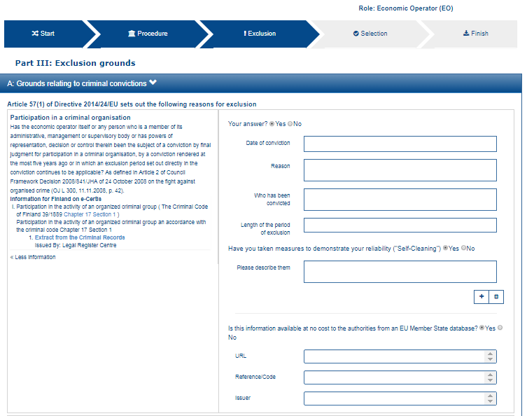
1
2
3
12
4
13
5
6
7
8
9
11
12

Slide 7
12
13

Slide 8
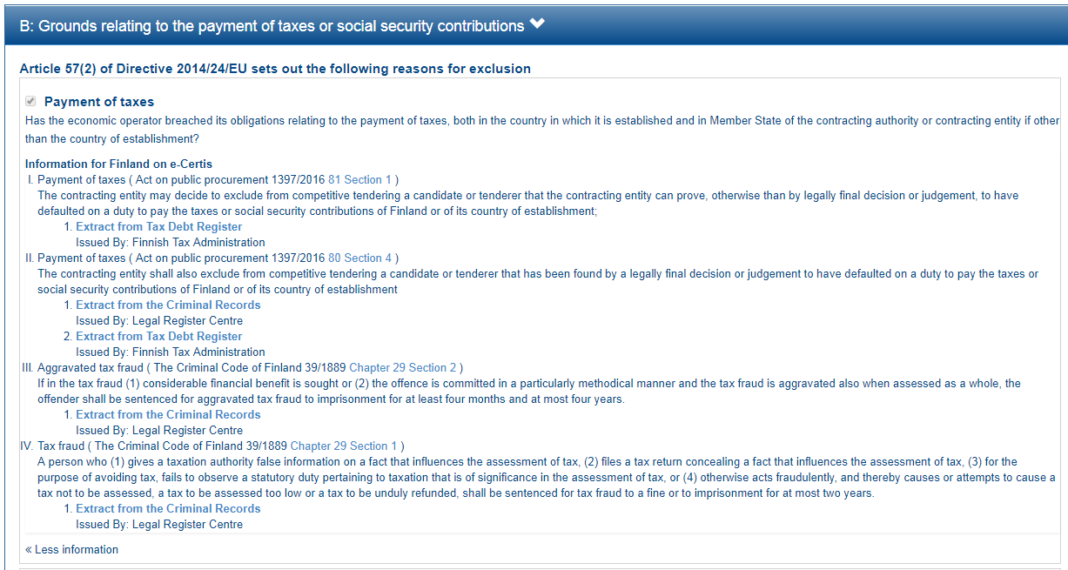

Slide 9
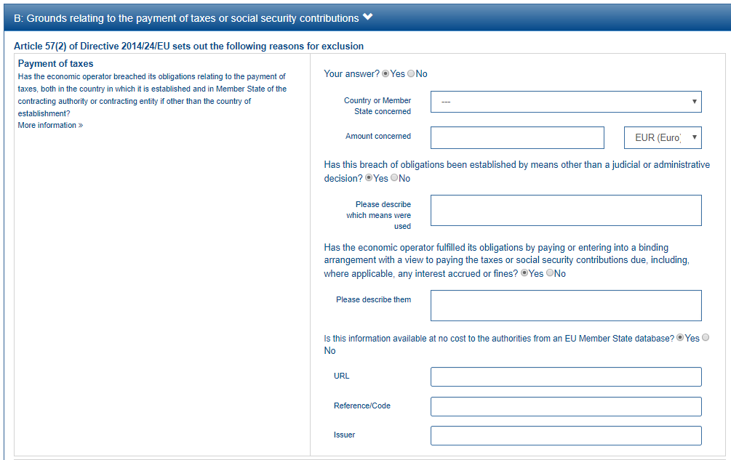
1
2
3
This property is shown only if the answer to the previous QUESTION is ‘Yes’
4
5
6
7
8

Slide 10
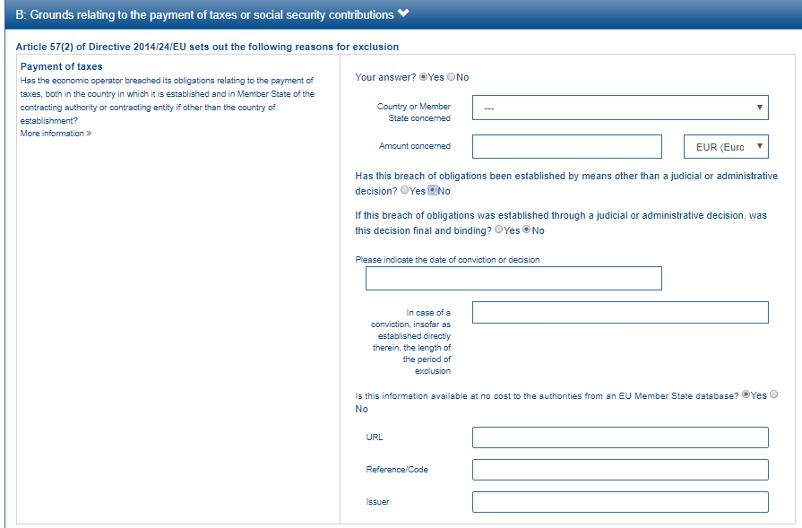
This group of property is shown only if the answer to the previous QUESTION is ‘No’
9
10

Slide 11
EU PoT Criterion
1
FI PoT Criterion I
2
FI PoT Criterion II
3
FI PoT Criterion III
4
FI PoT Criterion IV
5

Slide 12
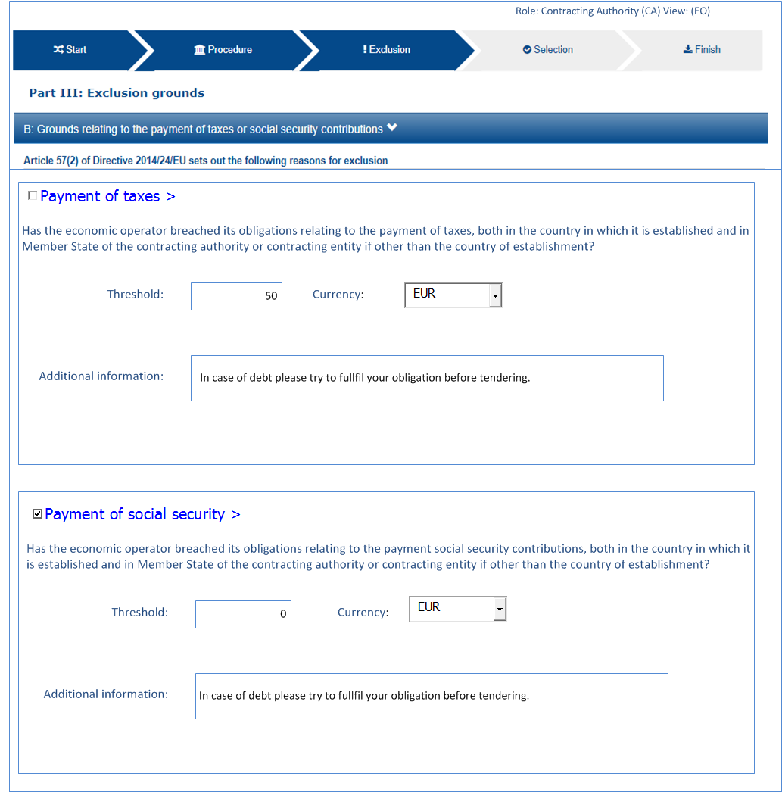
6
7
8

Slide 13
6
7
Minimum threshold: 50€
In case of debt please try to fulfil your obligation before tendering
8

Slide 14
2
3
4
5

Slide 15
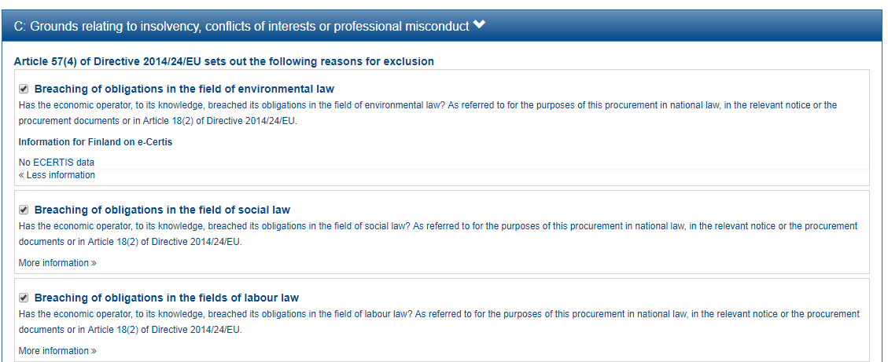

Slide 16
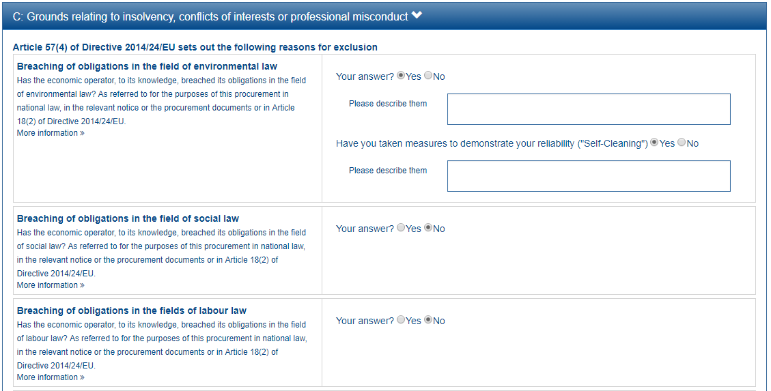
1
2

Slide 18
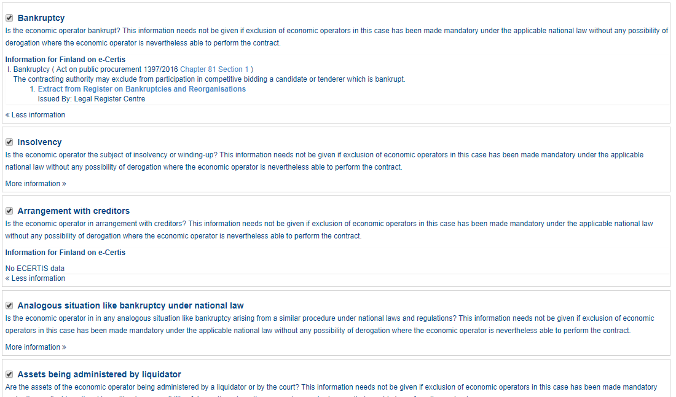

Slide 19
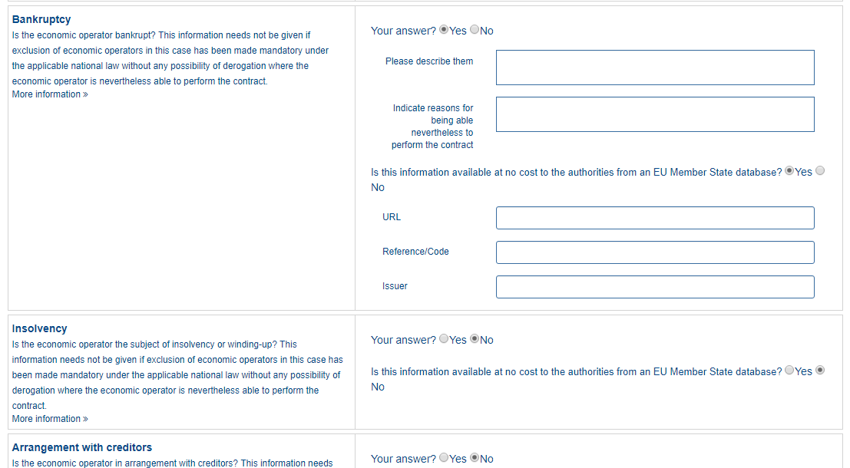
1
2
3
4
5
6

Slide 22
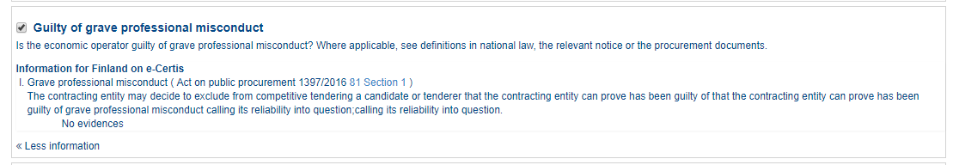

Slide 23
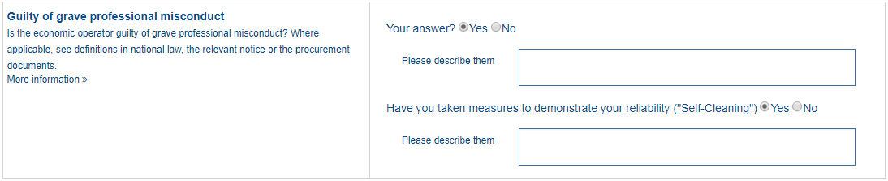
1
2

Slide 26
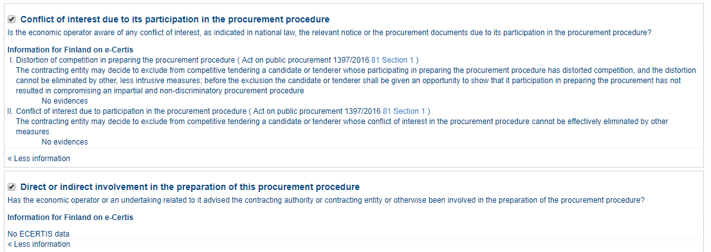

Slide 27
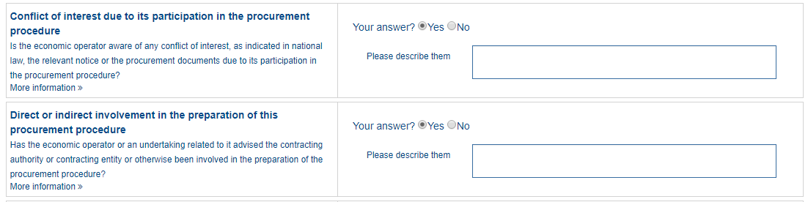
1

Slide 30
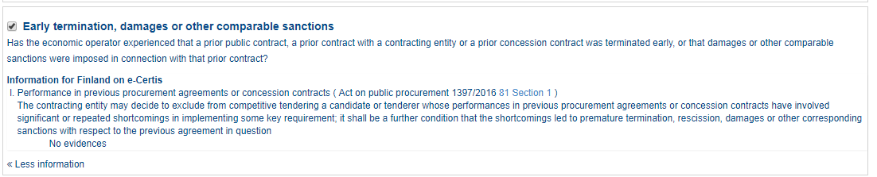

Slide 31
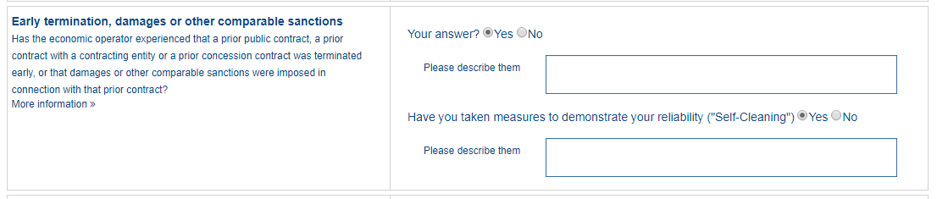
1
2

Slide 32
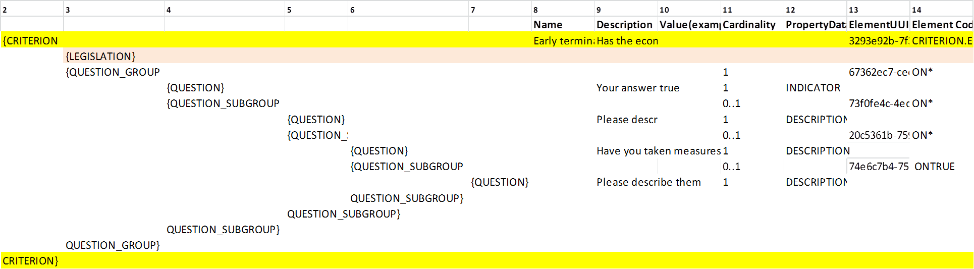

Slide 34
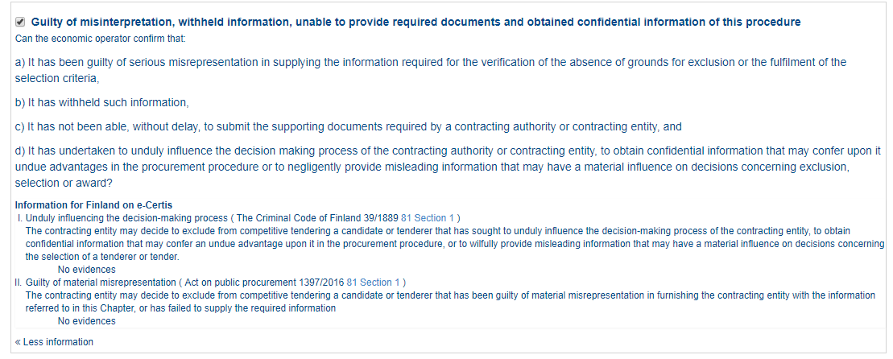

Slide 35
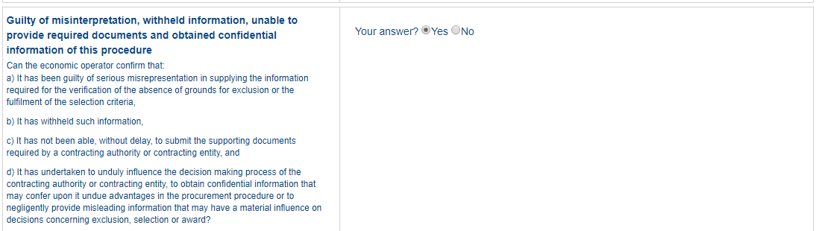
1

Slide 37
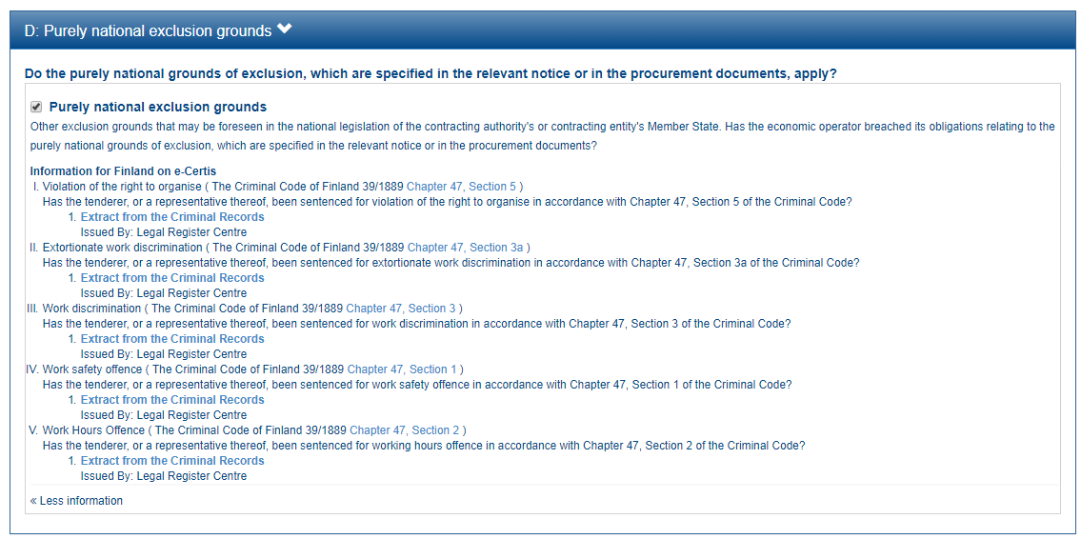

Slide 38
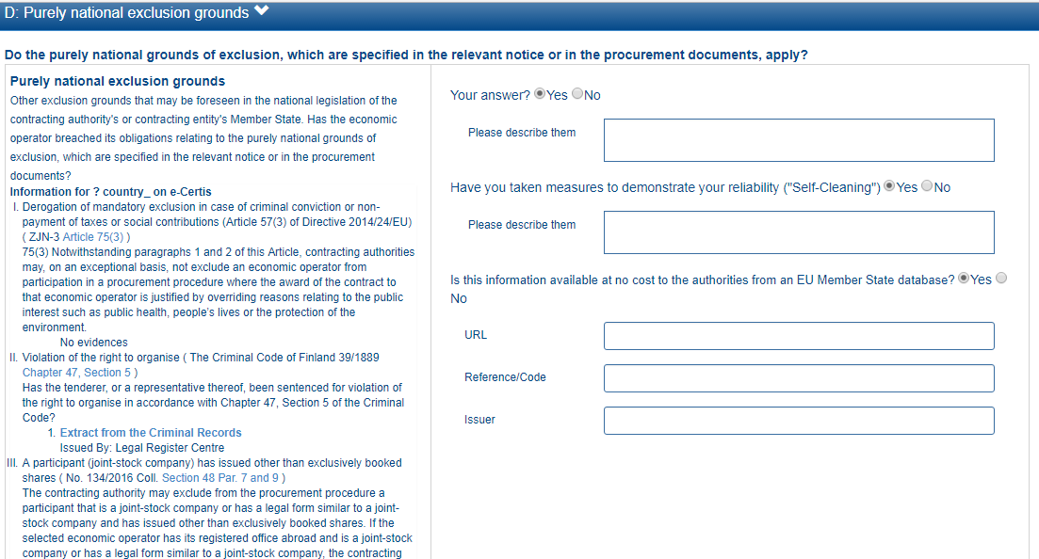
1
2
3
4
5
6

Slide 39
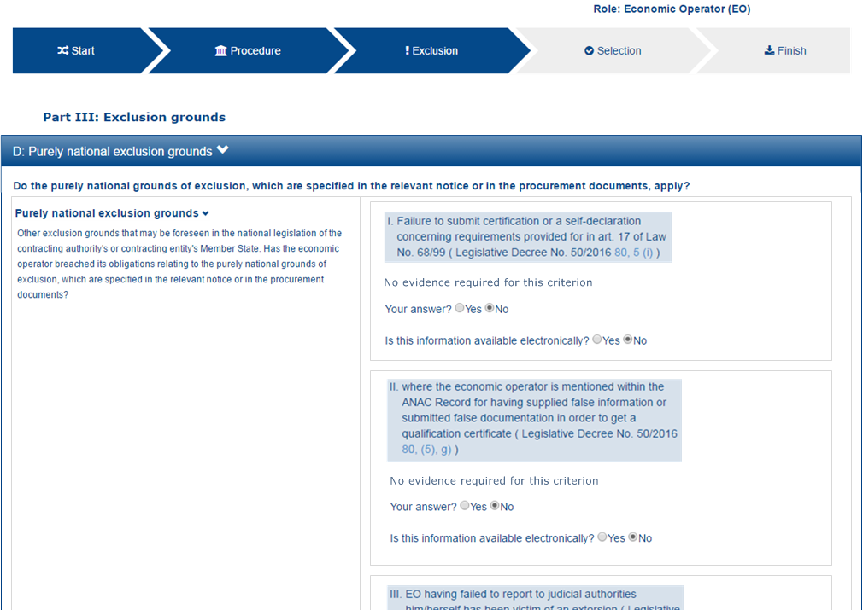
1
2

Slide 42
SELECTION
ECONOMIC_FINANCIAL_STANDING
PROFESSIONAL_REGISTER_ENROLMENT, TRADE_REGISTER_ENROLMENT
ECONOMIC_FINANCIAL_STANDING
TURNOVER
GENERAL_YEARLY, SPECIFIC_YEARLY
GENERAL_YEARLY, SPECIFIC_YEARLY
SET_UP
FINANCIAL_RATIO
RISK_INDEMNITY_INSURANCE
OTHER_REQUIREMENTS
TECHNICAL_PROFESSIONAL_ABILITY
REFERENCES
WORKS_PERFORMANCE, SUPPLIES_DELIVERY_PERFORMANCE, SERVICES_DELIVERY_PERFORMANCE
TECHNICAL.TECHNICIANS_FOR_QUALITY_CONTROL, TECHNICAL.TECHNICIANS_FOR_CARRYING_WORKS, TECHNICAL.FACILITIES_FOR_QUALITY_ENSURING, TECHNICAL.FACILITIES_FOR_STUDY_RESEARCH, TECHNICAL.SUPPLY_CHAIN_MANAGEMENT, TECHNICAL.PROFESSIONAL_QUALIFICATIONS, TECHNICAL.ENVIRONMENTAL_MANAGEMENT_MEASURES, TECHNICAL.EQUIPMENT
TECHNICAL.CHECKS.ALLOWANCE_OF_CHECKS
MANAGEMENT.MANAGERIAL_STAFF, MANAGEMENT.AVERAGE_ANNUAL_MANPOWER
MANAGEMENT.SUBCONTRACTING_PROPORTION
MANAGEMENT.ARTEFACTS.NO_AUTHENTICATED_ARTEFACTS
MANAGEMENT.ARTEFACTS.NO_AUTHENTICATED_ARTEFACTS, MANAGEMENT.ARTEFACTS.AUTHENTICATED_ARTEFACTS
CERTIFICATES.QUALITY_ASSURANCE.QA_INSTITUTES_CERTIFICATE, CERTIFICATES.QUALITY_ASSURANCE.QA_INDEPENDENT_CERTIFICATE

Slide 43
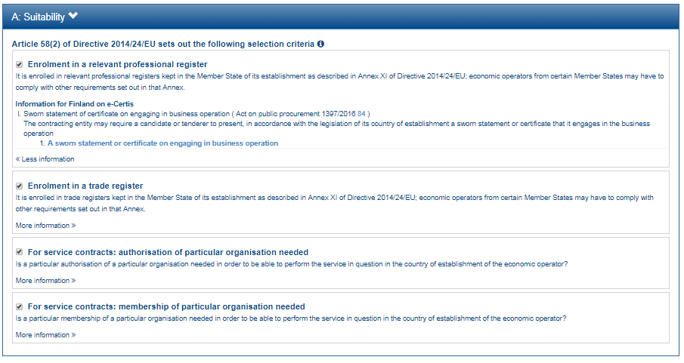

Slide 44
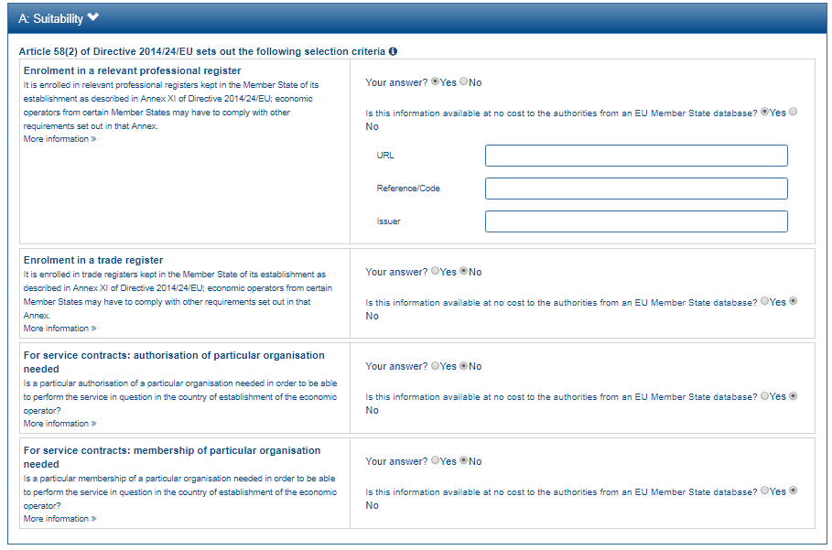
1
2
3
4
5

Slide 46
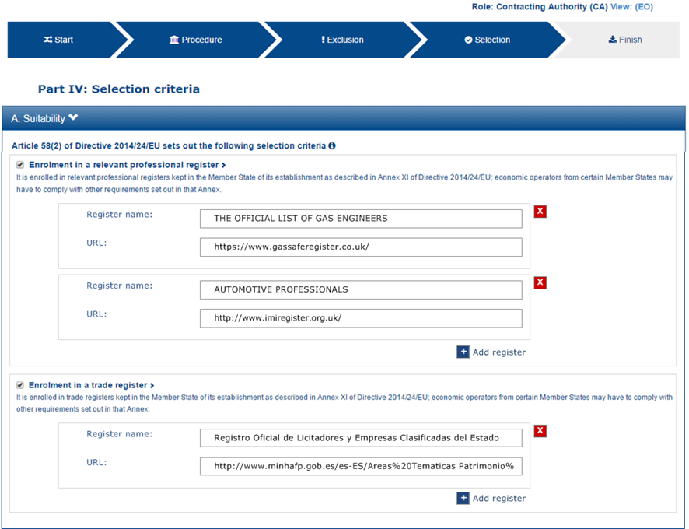

Slide 47
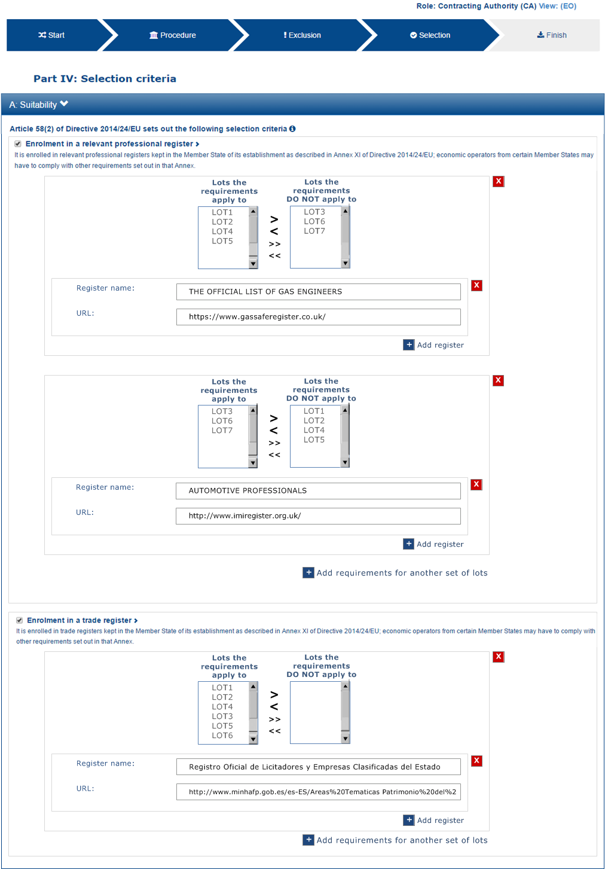
1
2
3

Slide 48
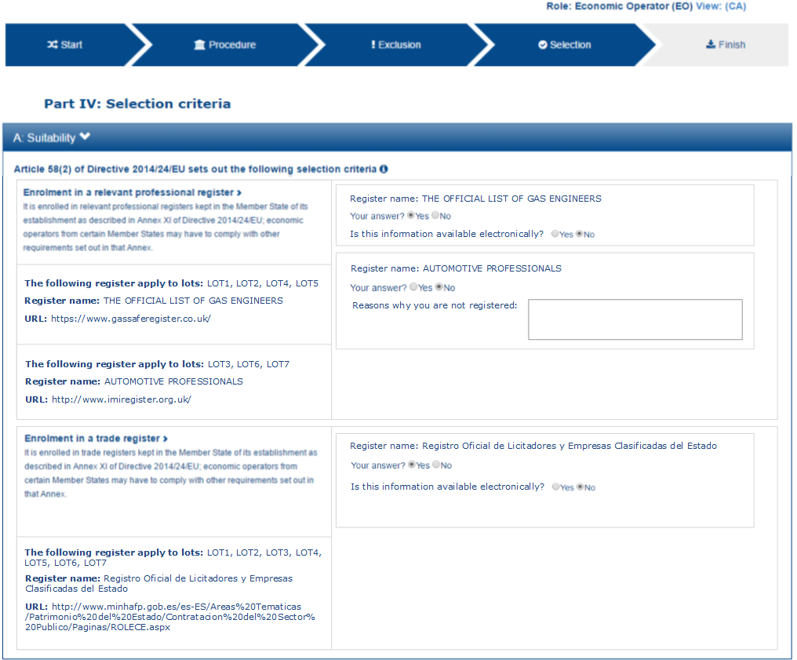
7
8
1
9
2
3
10
4
5
6

Slide 50
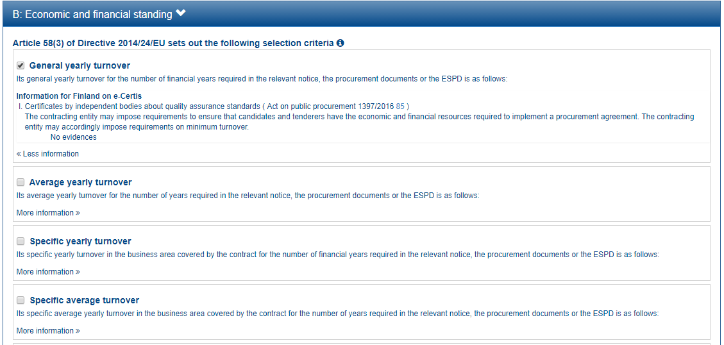
1
2
3

Slide 51
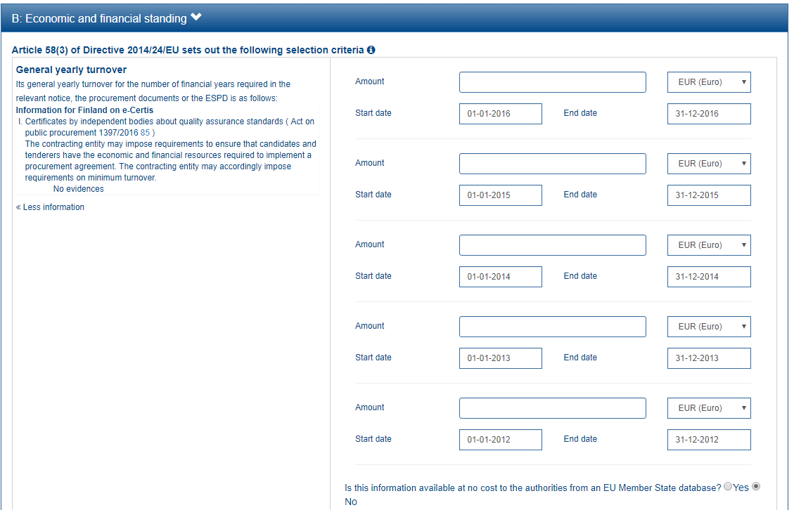
1
4
5
2
6
3
7
8
9
10
11
12
13
14

Slide 53
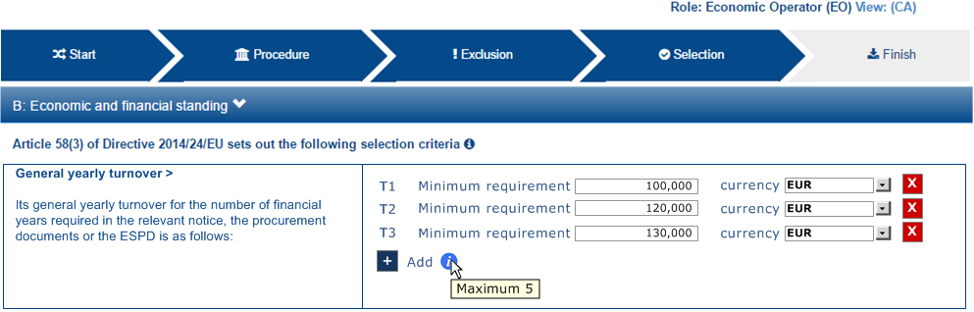
1
2
3

Slide 54
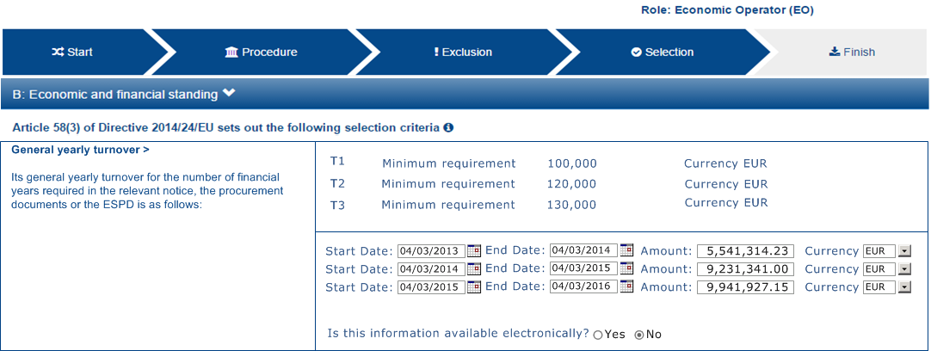
1
2
3

Slide 56
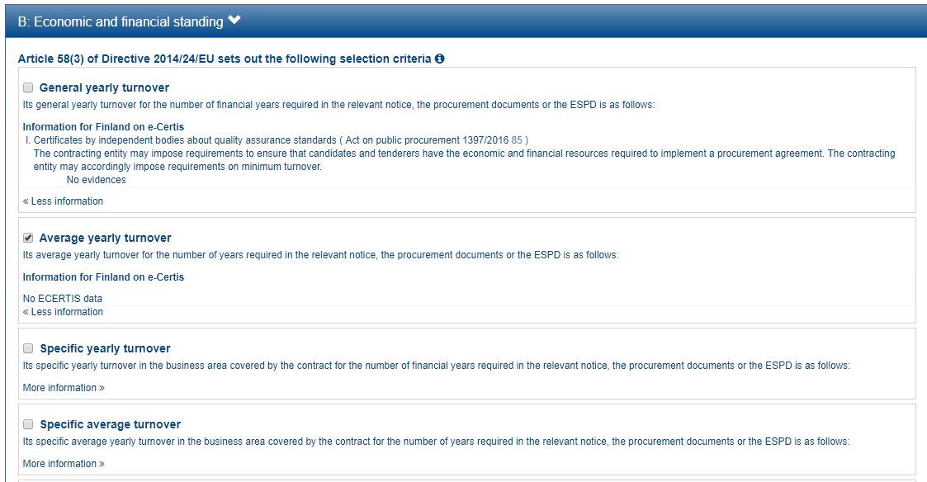
1
2
3

Slide 57
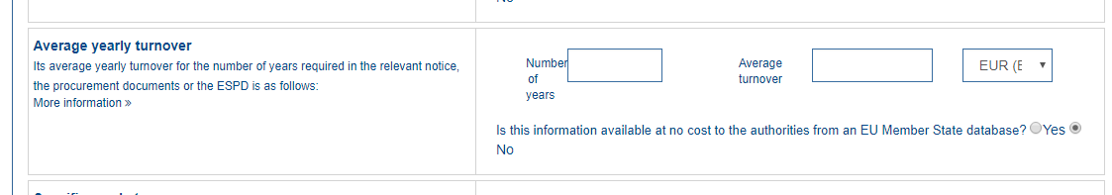

Slide 59
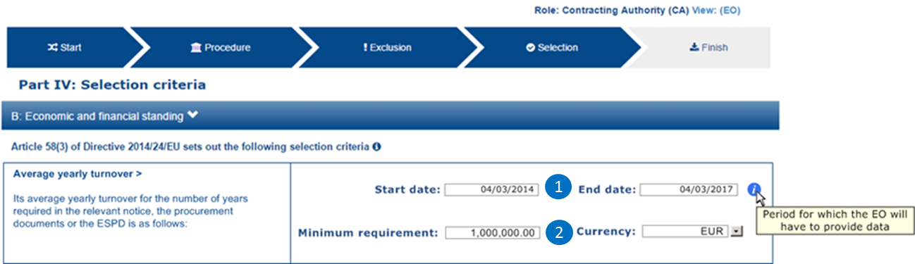

Slide 60
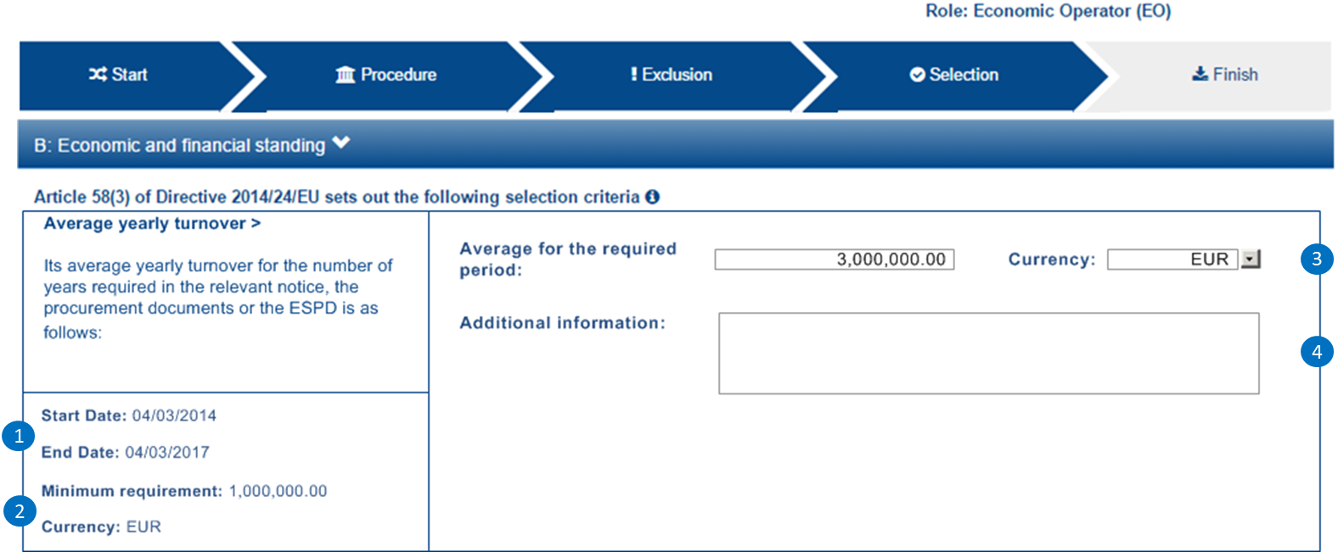

Slide 62
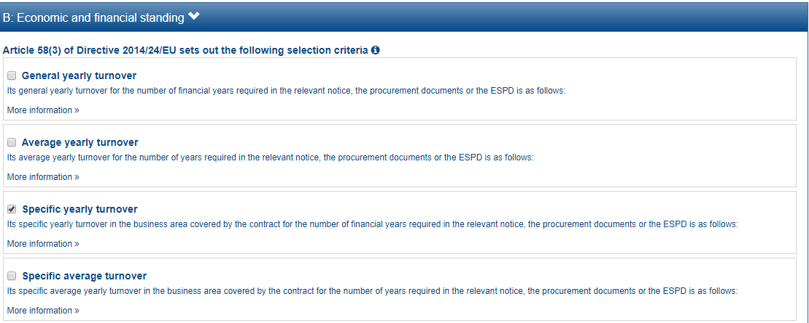

Slide 63
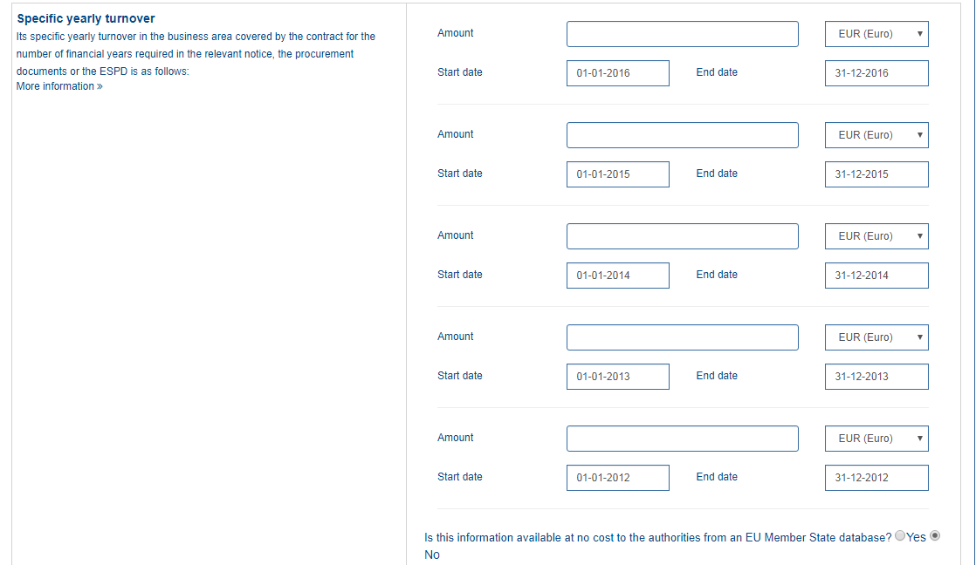
1
2
3
4
5
6
7
8
9
10
11

Slide 65
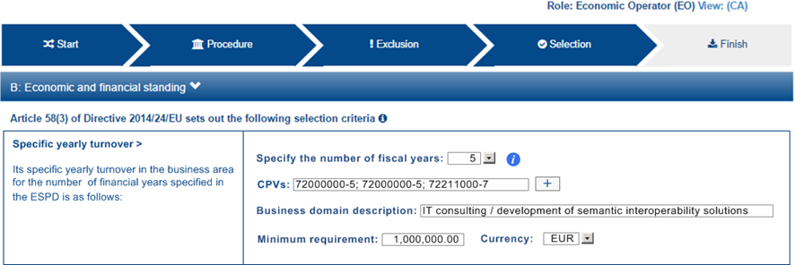
1
2
3
4

Slide 66
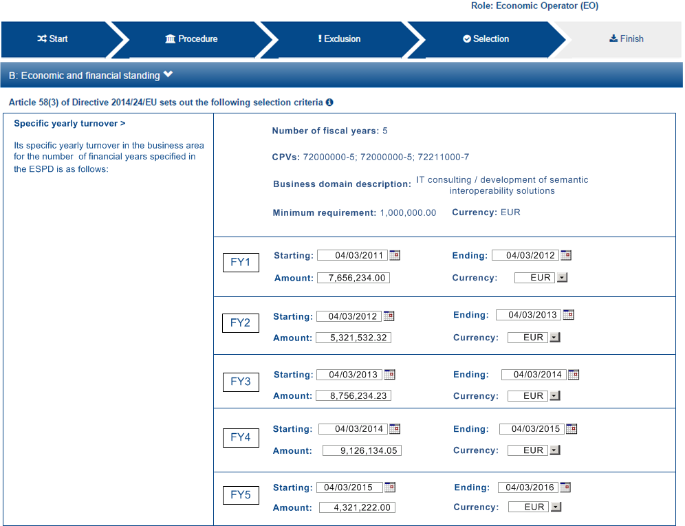
1
2
3
4
5
6
7
8
9
10
11
12
13
14

Slide 68
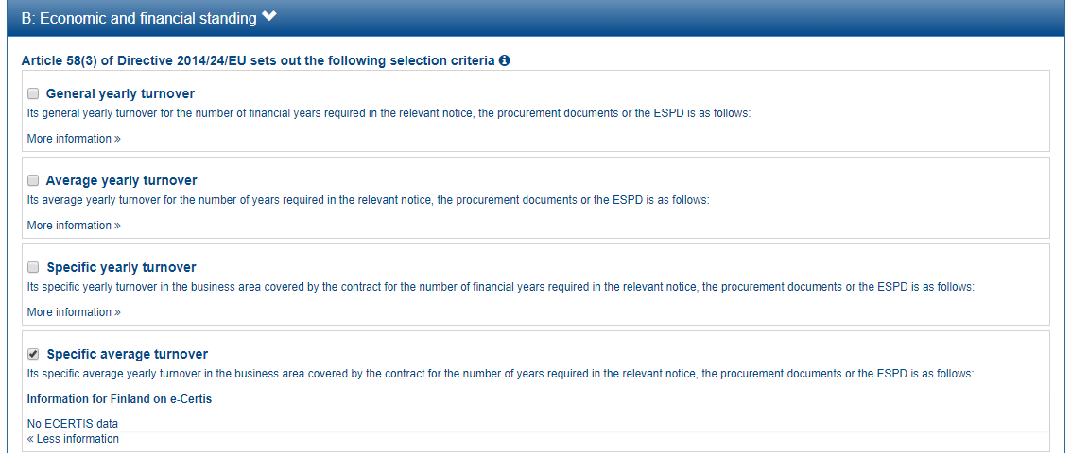

Slide 69
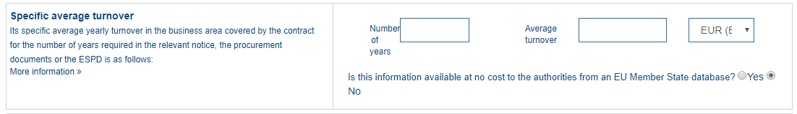
1
2
3

Slide 71
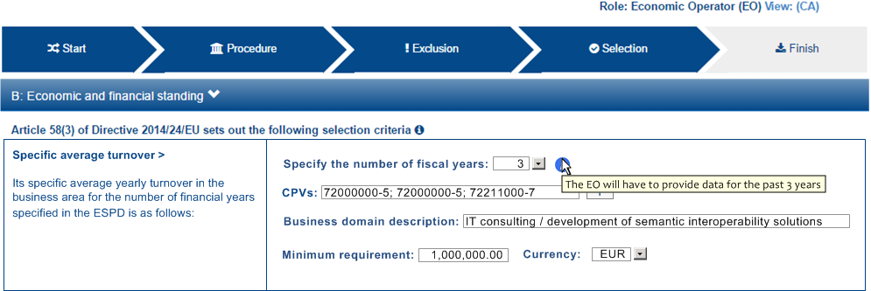
1
2
3
4

Slide 72
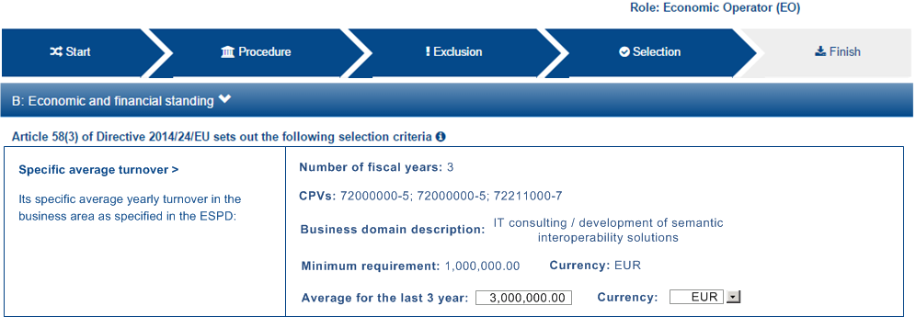
1
2
3
4
5

Slide 74
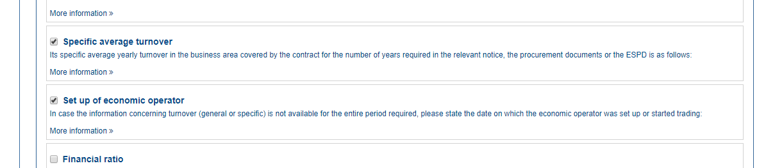

Slide 75
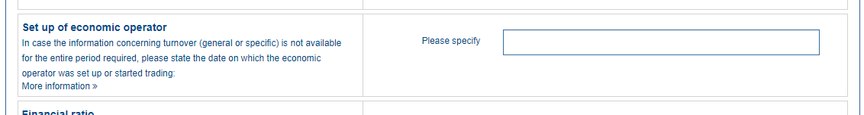
1

Slide 78
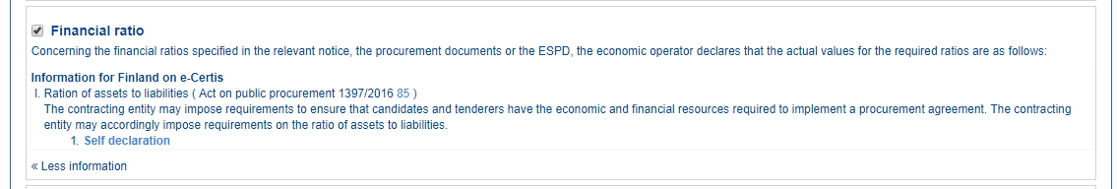

Slide 79
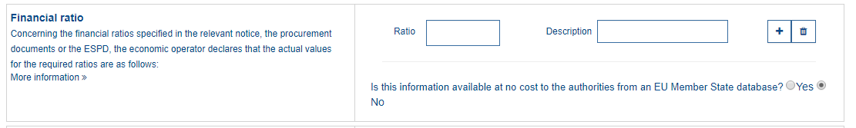
1
2

Slide 81

1
2
3
4
5
6
7
8
9
10

Slide 82


Slide 84


Slide 85

1

Slide 88

1
2

Slide 89

3
1
2

Slide 90

3
1
2
4
5

Slide 92


Slide 93

1

Slide 95

1
2
3
4
5
6
7
8

Slide 96

9
1
3
4
5

Slide 98


Slide 99

1
2
3
4

Slide 101

1
2

Slide 102


Slide 104


Slide 105

1
2

Slide 107

1

Slide 108

1
2
3
4
5
6
7
8
9
10
11

Slide 110


Slide 111


Slide 112

1

Slide 115

1

Slide 116

1
2

Slide 118


Slide 119

1
2
3
4

Slide 122

1
2

Slide 123

3
1
4
2
5

Slide 125


Slide 127


Slide 128


Slide 131


Slide 132

1
2

Slide 134

1

Slide 135

1
2
3
4
5

Slide 137

1
7
2
8
3
9
4
10
5
11
6
12

Slide 138

13
14
15

Slide 139

12
13
14
15
16

Slide 140

17
18
19
20

Slide 141

21

Slide 142

35
36

Slide 143

30

Slide 144

34
33

Slide 145

1
7
2
8
3
9
4
10
5
11
6
12
13
14
15
16
17
18
19
20
21
22
23
24
25
26
27
28
29
30

Slide 150


Slide 151


Slide 153


Slide 154

31
32
33
34

Slide 155

35
36
37
38

Slide 156


Slide 157

1
8
2
9
3
10
4
11
5
12
6
7

